Slide 1
Lecture 8 Voltage and current division rule

Slide 2
Connection of elements!!
Resistance in series.
Voltage division rule.
Resistance in parallel.
Current division rule.

Slide 3
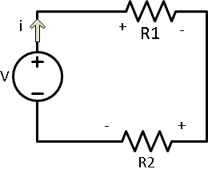
Series resistance and Voltage division
Let V₁,V₂ be the voltages
Across R₁ and R₂ respectively.
V₁= iR₁ and V₂= iR₂ → (eq 1)
V-V₁-V₂=0 → (eq2)
V-iR₁-iR₂=0 → (eq3)
V=i(R₁+R₂)
i=V/(R₁+R₂) →(eq4)
V₁=V*R₁/(R₁+R₂)
V₂=V*R₂/(R₁+R₂)

Slide 4
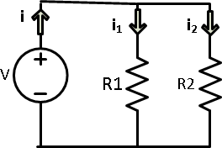
Parallel resistance and Current division
Let i₁,i₂ be the current
through R₁ and R₂ respectively.
i₁= V/R₁= i. R_{eq}/ R₁
=i(R₁R₂)/(R₁+R₂)
=iR₂/(R₁+R₂)
V= i₁R₁ and V= i₂R₂
i₁=V/R₁ and i₂=V/R₂→ (eq1)
i= i₁+i₂
= V/R₁ + V/R₂
= V ( 1/R₁ + 1/R₂)
= V/R_{eq}
V= i. R_{eq} →(eq2)
i₁=i*R₂/(R₁+R₂)
i₂=i*R₁/(R₁+R₂)

Slide 5
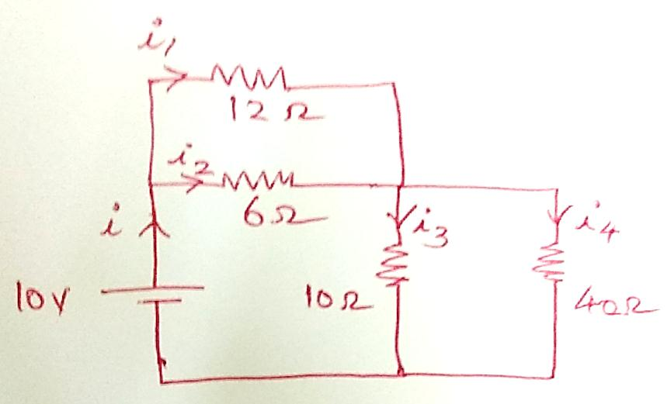
Exercise 1. Find current through the branches.
Step 1. Find R_{eq}
10 Ω || 40 Ω = 8 Ω
12 Ω ||6 Ω = 4 Ω
R_{eq}= 8+4= 12 Ω
i= V/R_{eq}
= 10/12
=0.833 A
Current division rule
i₁=i*R₂/(R₁+R₂)
i₂=i*R₁/(R₁+R₂)

Slide 6
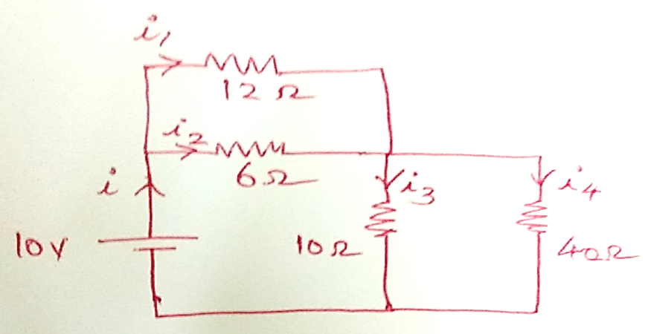
Continued…
i₁= 0.833 * 6/(6+12)
= 0.278 A
i₂= 0.833* 12/ (6+12)
=0.553A
Similarly
i₃= 0.833*40/(10+40)
=0.66A
i₄=0.833*10/(10+40)
=0.166A

Slide 7
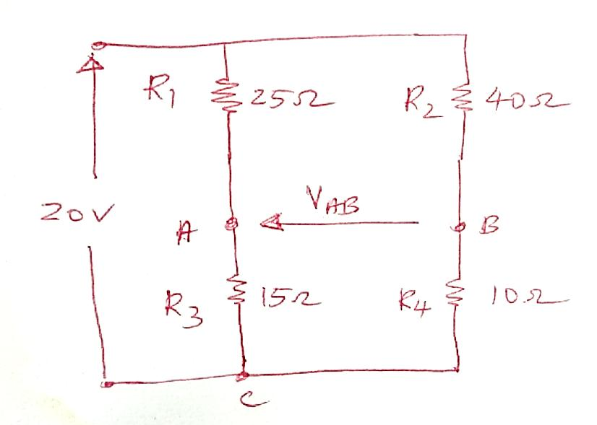
Exercise 2. Calculate V_{AB} for the network.
Applying Voltage division rule.
V₁=V*R₁/(R₁+R₂)
V₂₁=V*R₂/(R₁+R₂)
Apply KVL in loop ABC
V_{AB}+V_{BC}+V_{CA}=0
V_{AB}+V_{BC}-V_{AC}=0
V_{AB}= V_{AC}- V_{BC}
=7.5-4
=3.5V
V_{AC}= R₃.V/ (R₁+R₃)
= 15*20/(15+10)
=7.5V
V_{BC}= R₄.V/(R₂+R₄)
=10.20/(40+10)
=4V

Slide 8
Thank you
Lecture 8

